Slide 1
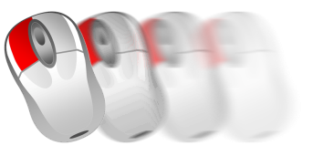
Edit images in PowerPoint 2003

Slide 2
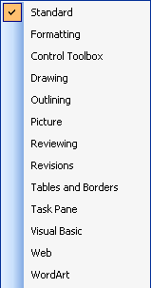
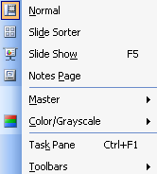
Show graphics-menu
PowerPoint 2003
1
3
2
1
To edit your images in your presentation you require the graphics menu.
Simply select “View” in the menu.
2
Select „Toolbars“
3
Choose “picture” to open the window with the graphic elements.

Slide 3
Scaling pictures proportionally
PowerPoint 2003
2
1
+
1
Scaling the images to the required size you need to select the picture with a left mouse-click.
2
Pull the image on its corner points to the size you wish by holding down the mouse- and the shift-button simultaneously.

Slide 4
Convert picture in black and white
PowerPoint 2003
1
2
1
Click with the left mouse-button on the picture.
2
Choose in the graphic-window “ color- symbol” followed by “Greyscale”

Slide 5
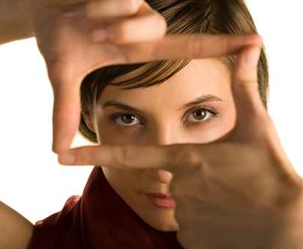
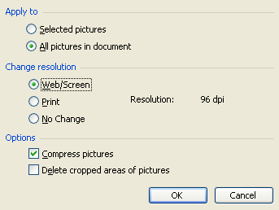
Compress pictures
PowerPoint 2003
1
2
3
1
You can compress your pictures to a smaller file size. Select the image with the left mouse-button.
2
Click the menu- window graphic on the symbol “compress picture”
3
Choose “Web/Screen” and “Compress pictures” to minimize the file size of your pictures to optimize it for web pages or projectors.

Slide 6
Cut pictures
PowerPoint 2003
1
2
1
Select the image and click in the menu-window graphic the icon “cut”
2
Cut-marks will be appearing on the edges of the pictures. While pulling and holding the mouse-button you will cut the edge of the picture.

Slide 7
Adjust contrast
PowerPoint 2003
1
2
1
Select the picture that needs some contrast or brightness adjustments with a left mouse-click
2
In the menu-window graphic you’ll find the option to select the correct brightness-level for your presentation.

Slide 8
PowerPoint 2007
Edit images in PowerPoint 2007

Slide 9
Scaling pictures proportionally
PowerPoint 2007
2
1
+
1
Scaling the images proportionally to the required size you need to select the picture with a left mouse-click.
2
Pull the image on its corner points to the size you wish by holding down the mouse- and the shift-button simultaneously.

Slide 10
Convert picture in black and white
PowerPoint 2007
1
2
1
Start with a double click on the selected picture. The register “Format” will open in the top menu with all the editing options.
2
Choose „Adjust “ the function „Recolor“ and then in the „Color Modes“ grey.

Slide 11
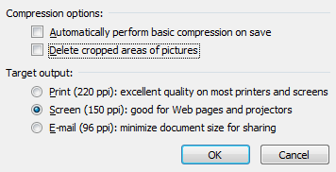
Compress pictures
PowerPoint 2007
1
2
3
1
You can transfer the picture to smaller fil-sizes . Select the required picture with a double click. The register„Format“ will open in the task menu.
2
You choose „Adjust“ then the function „Compress Pictures“.
3
In the dialog window for the compression you click “Options” and choose in the next window „Screen (150 ppi)“, to minimize the file size of your pictures to optimize it for web pages or projectors.

Slide 12
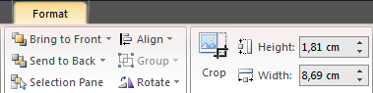
Cut pictures
PowerPoint 2007
1
2
1
Select the picture and choose „Format” in the top register. Then you select the icon “cut”.
2
While holding the left mouse button you are able to pull the image on the “cut-marks” without altering the original image.

Slide 13
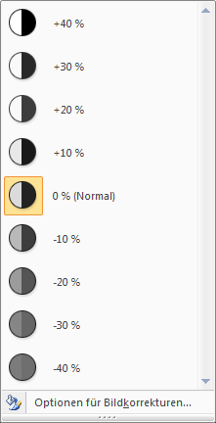
Adjust contrast
PowerPoint 2007
1
2
3
1
Start with a double click on the selected picture. The register “Format” will open in the top menu with all the editing options.
2
In the section „Adjust“ you’ll find the functions „Brightness“ and „Contrast“.
3
After selecting one of these options you can set in the window the percentage of the contrast or brightness adjustment.

Slide 14
Add visual effects (Pictureformats)
PowerPoint 2007
2
1
1
Start with a double click on the picture. The register “Format” will open in the top menu with all the editing options.
2
You can select in defined „Picture Styles“ several picture effects. In this example it shows rounded corners and a mirror effect.

Slide 15
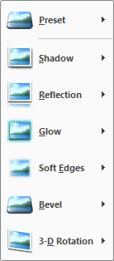
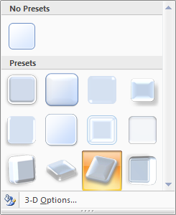
Add 3D Picture effects
PowerPoint 2007
1
2
3
1
Start with a double click on the picture. The register “Format” will open in the top menu with all the editing options.
2
In the section „Picture Styles“ you can select “Picture Effects”.
3
For the shown effect you choose „Preset“ and the red marked style.

Slide 16
Bilder neu einfärben
PowerPoint 2007
1
2
1
Start with a double click on the picture. The register “Format” will open in the top menu with all the editing options.
2
In the section „Adjust“ choose the function „Recolor”. In this option you can choose different variations. Like here in the example “Dark Variation”.

Slide 17
www.PresentationLoad.com

Slide 18
PowerPoint 2010
Edit images in PowerPoint 2010

Slide 19
Scaling pictures proportionally
PowerPoint 2010
2
1
+
1
Scaling the images proportionally to the required size you need to select the picture with a left mouse-click.
2
Pull the image on its corner points to the size you wish by holding down the mouse- and the shift-button simultaneously.

Slide 20
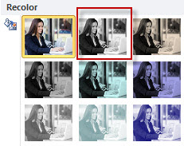
Convert picture in black and white
PowerPoint 2010
1
2
1
Start with a double click on the selected picture. The register “Format” will open in the top menu with all the editing options.
2
Choose „Adjust “ the function „Color“, „Recolor“ and then in the „Color Modes“ grey.

Slide 21
Compress pictures
PowerPoint 2010
1
2
3
1
You can transfer the picture to smaller fil-sizes . Select the required picture with a double click. The register„Format“ will open in the task menu.
2
You choose „Adjust“ then the function „Compress Pictures“.
3
In the dialog window for the compression you click “Options” and choose in the next window „Screen (150 ppi)“, to minimize the file size of your pictures to optimize it for web pages or projectors.

Slide 22
Cut pictures
PowerPoint 2010
1
2
1
Select the picture and choose „Format” in the top register. Then you select the icon “cut”.
2
While holding the left mouse button you are able to pull the image on the “cut-marks” without altering the original image.

Slide 23
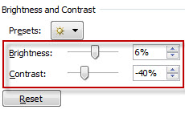
Adjust contrast
PowerPoint 2010
1
2
3
1
Start with a double click on the selected picture. The register “Format” will open in the top menu with all the editing options.
2
In the section „Adjust“ you’ll find under “Corrections” the function „Picture Corrections Options“.
3
After selecting this option you can set in the window the percentage of the contrast or brightness adjustment.

Slide 24
Add visual effects (Pictureformats)
PowerPoint 2010
2
1
1
Start with a double click on the picture. The register “Format” will open in the top menu with all the editing options.
2
You can select in defined „Picture Styles“ several picture effects. In this example it shows rounded corners and a mirror effect.

Slide 25
Add 3D Picture effects
PowerPoint 2010
1
2
3
1
Start with a double click on the picture. The register “Format” will open in the top menu with all the editing options.
2
In the section „Picture Styles“ you can select “Picture Effects”.
3
For the shown effect you choose „Preset“ and the red marked style.

Slide 26
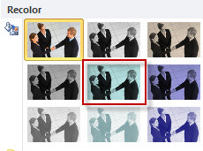
Recolor pictures
PowerPoint 2010
1
2
1
Start with a double click on the picture. The register “Format” will open in the top menu with all the editing options.
2
In the section „Adjust“ choose “Color” and then the function „Recolor”. In this option you can choose different variations. Like here in the example “Dark Variation”.

Slide 27
www.PresentationLoad.com

